Slide 1

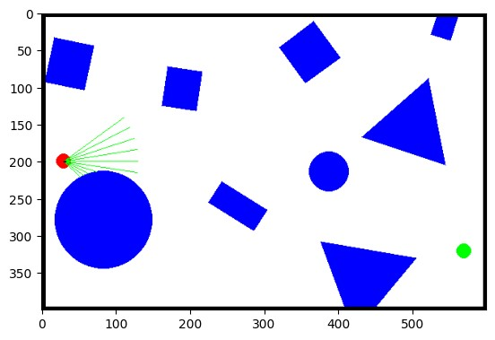

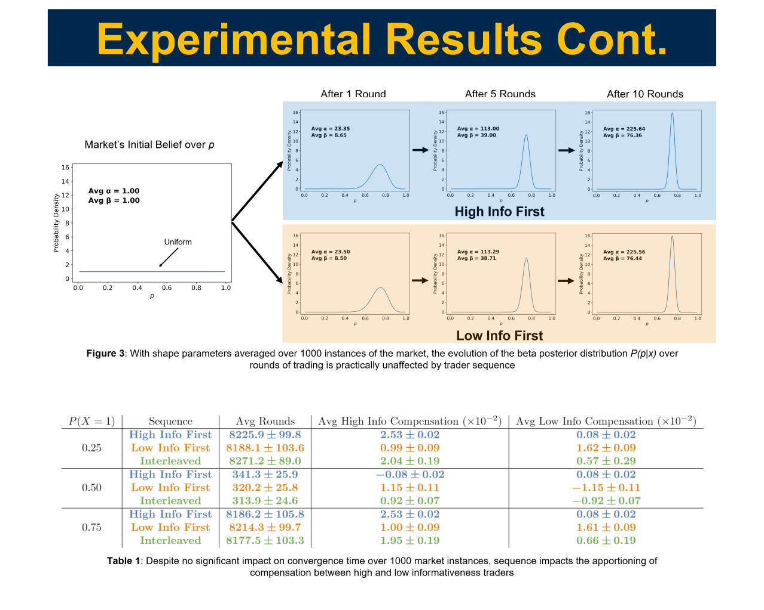
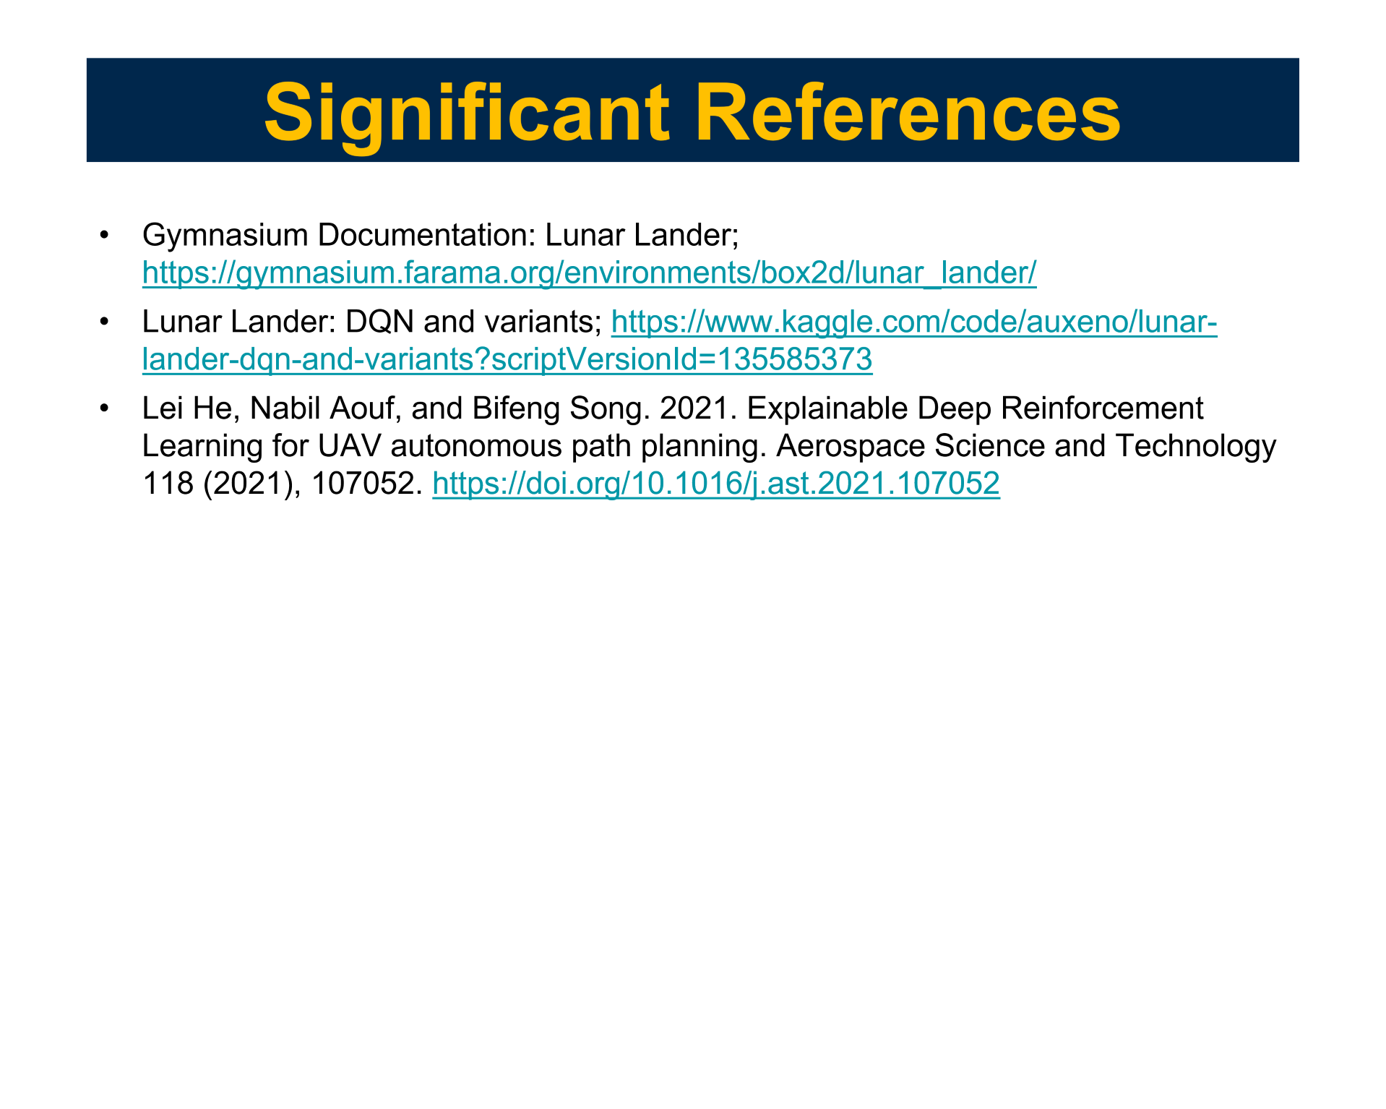
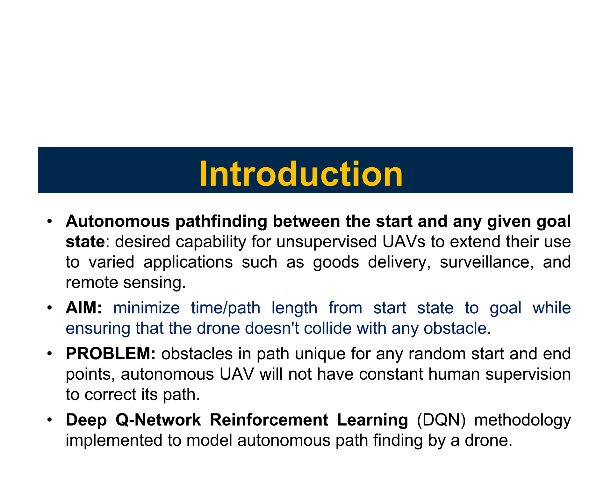
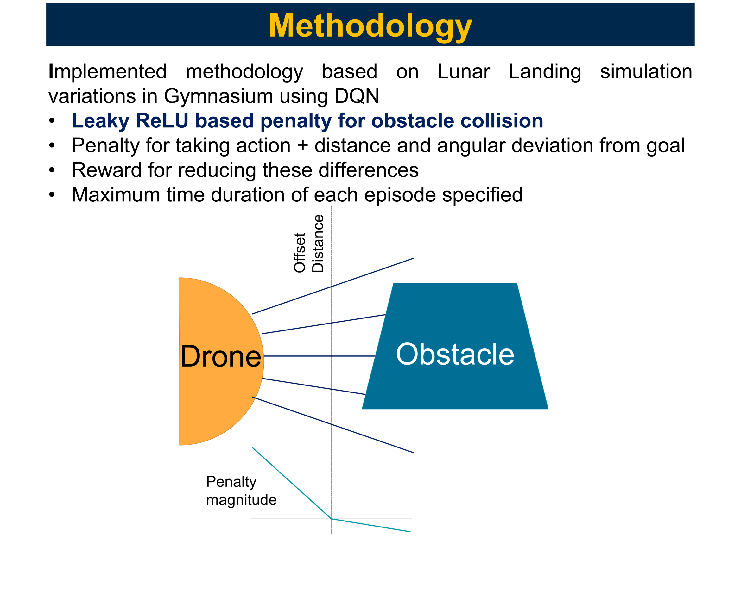
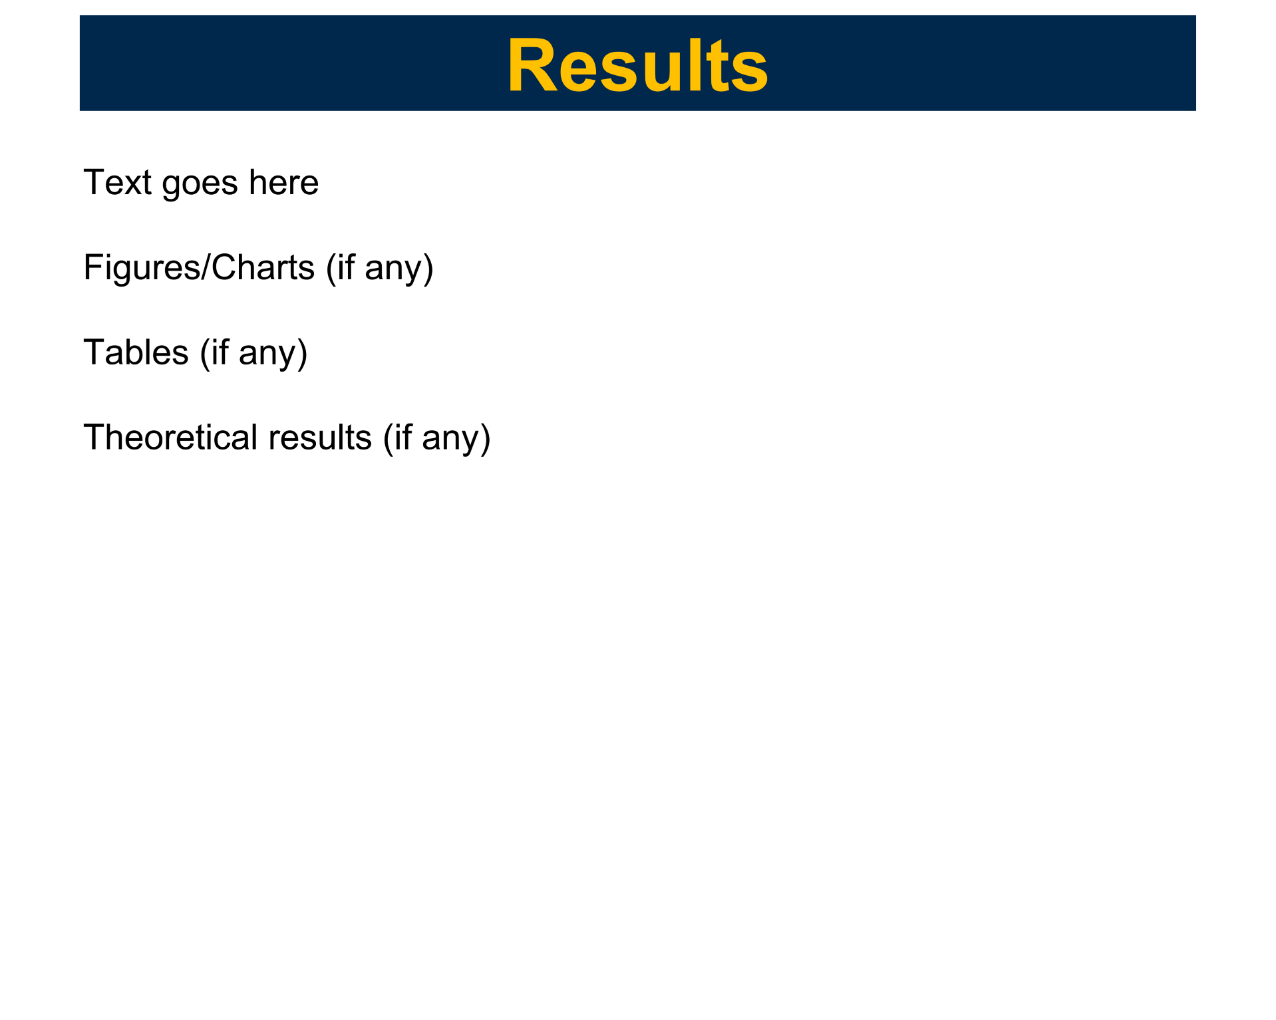
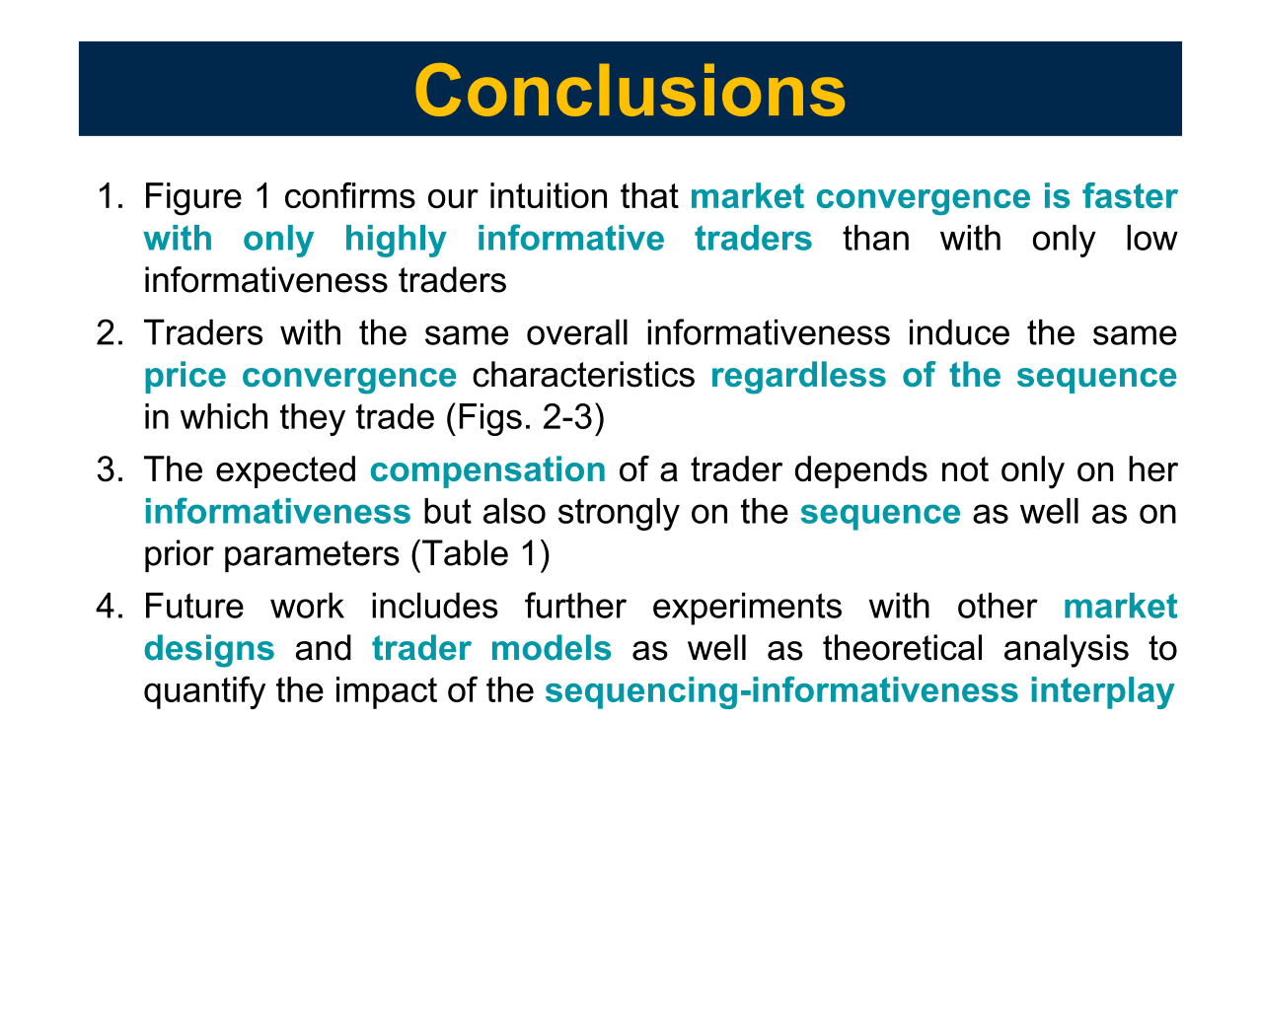
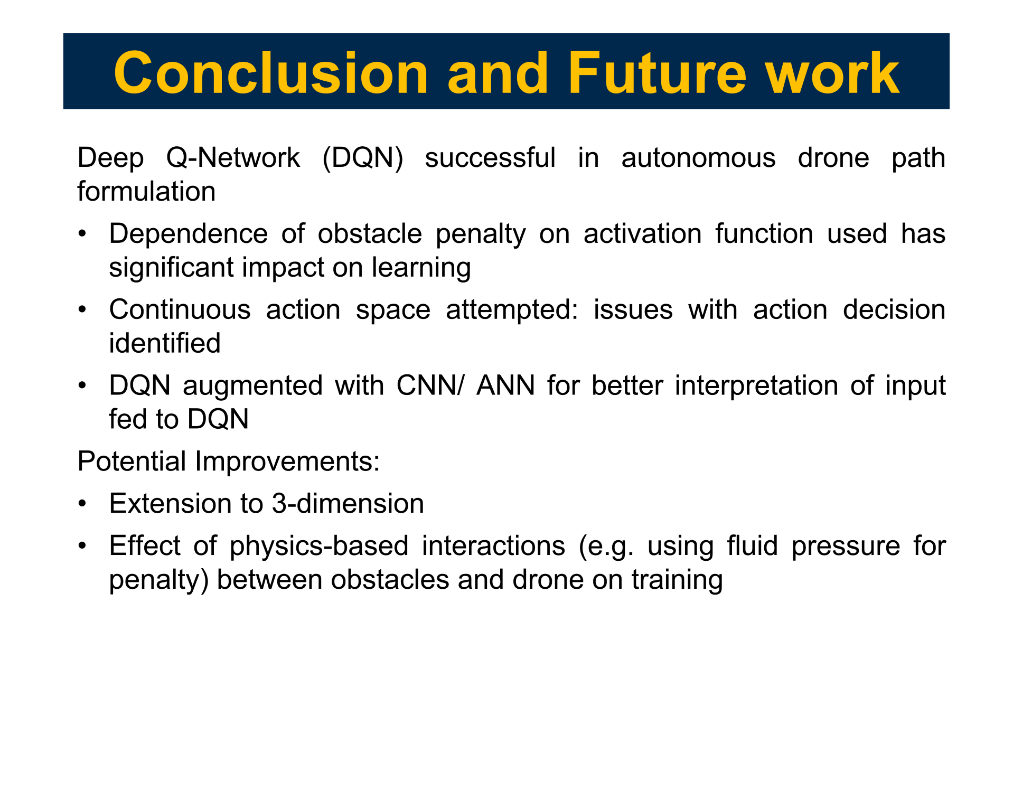
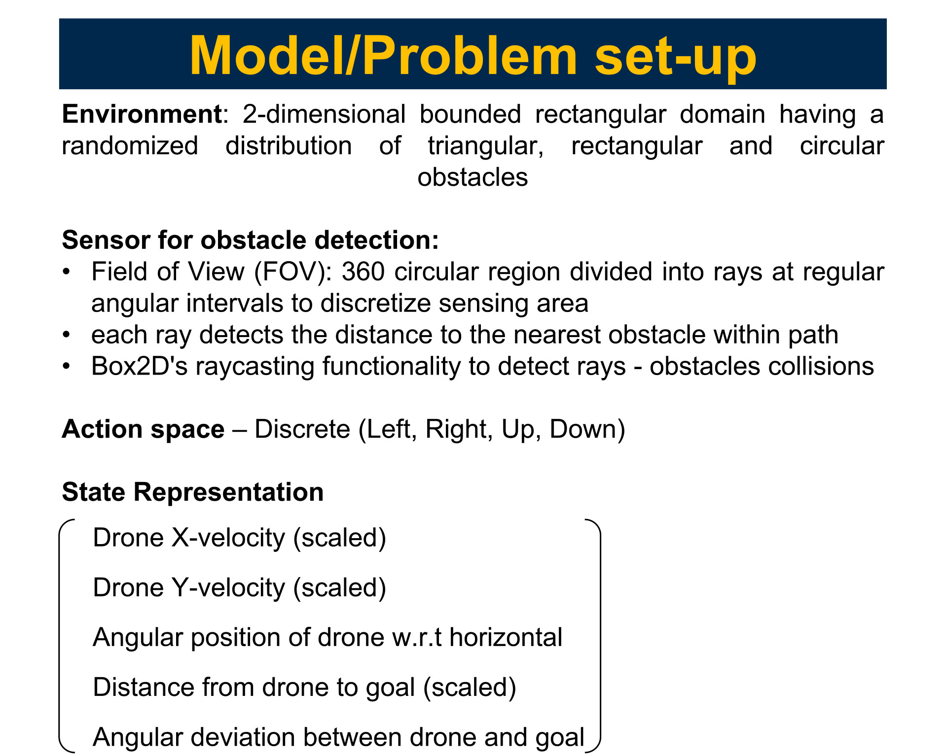
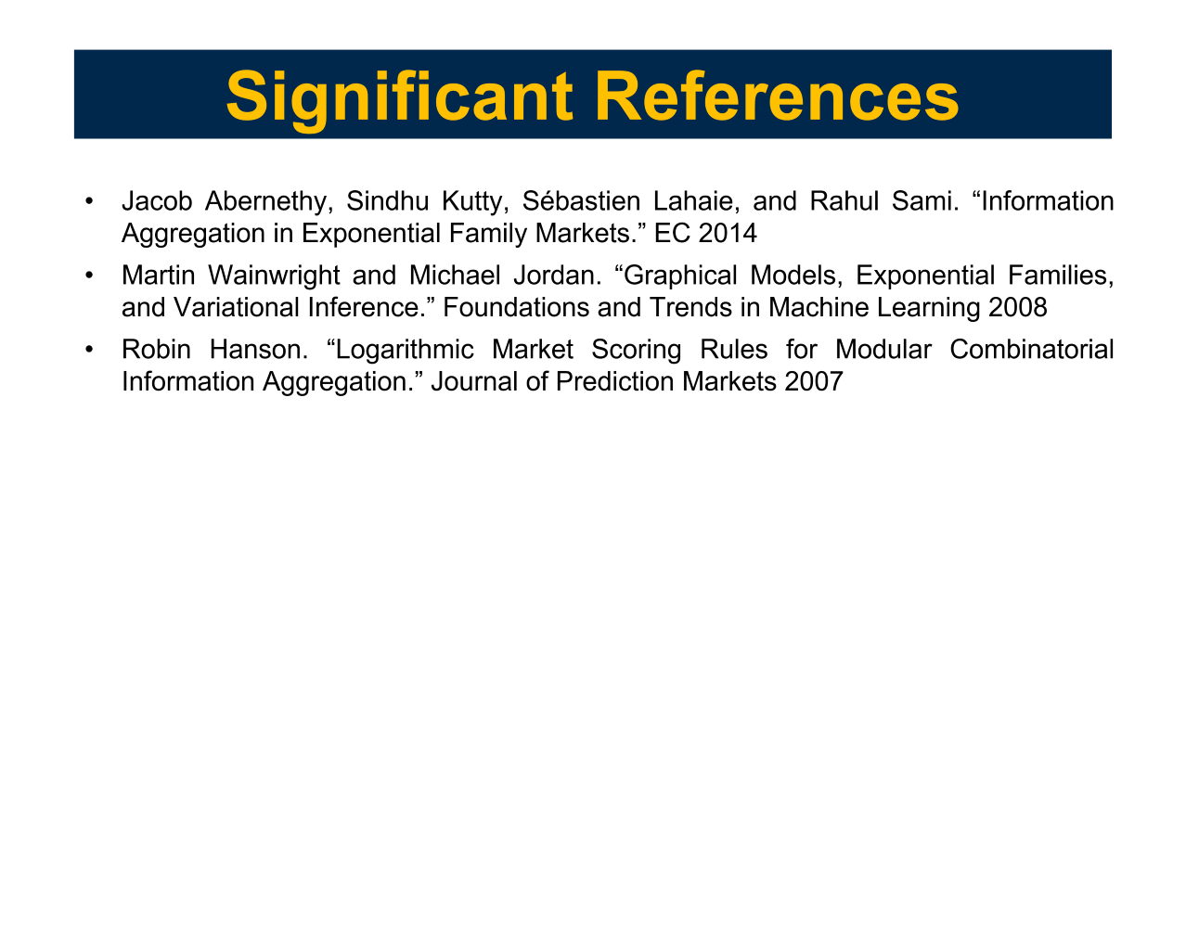

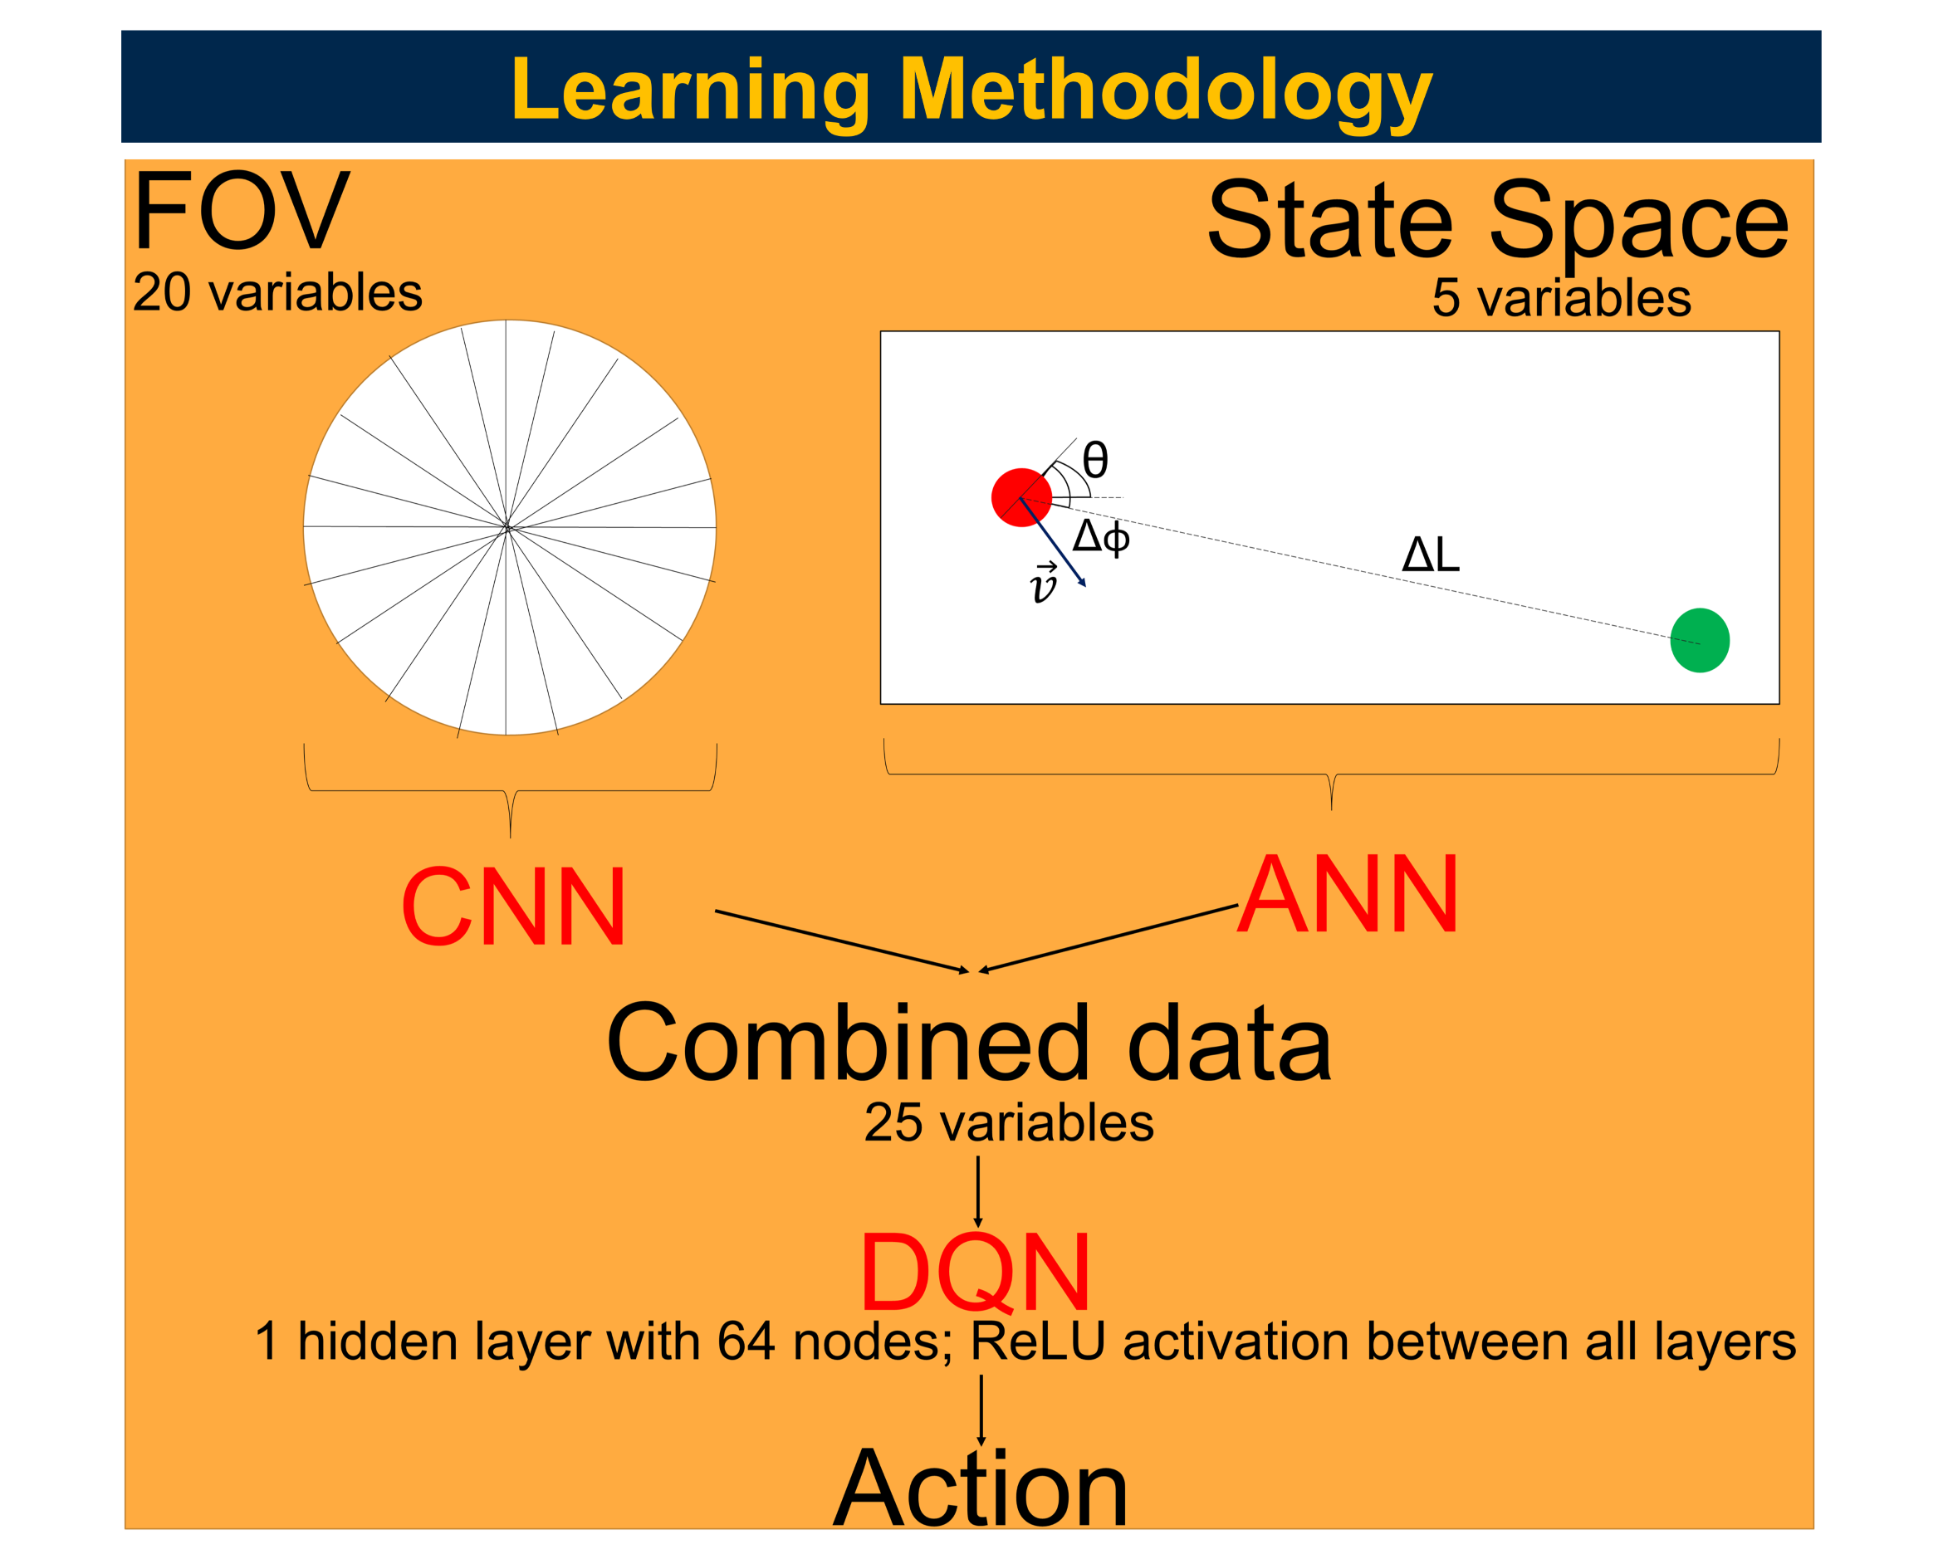
EECS 592: Autonomous Path Finding for Drones using Deep Reinforcement Learning
YILIN ZHUANG and MOON BAKAYA HAZARIKA
Department of Aerospace Engineering, University of Michigan Ann Arbor

Slide 2
Introduction
Autonomous pathfinding between the start and any given goal state: desired capability for unsupervised UAVs to extend their use to varied applications such as goods delivery, surveillance, and remote sensing.
AIM: minimize time/path length from start state to goal while ensuring that the drone doesn't collide with any obstacle.
PROBLEM: obstacles in path unique for any random start and end points, autonomous UAV will not have constant human supervision to correct its path.
Deep Q-Network Reinforcement Learning (DQN) methodology implemented to model autonomous path finding by a drone.

Slide 3
Model/Problem set-up
Environment: 2-dimensional bounded rectangular domain having a randomized distribution of triangular, rectangular and circular obstacles
Sensor for obstacle detection:
Field of View (FOV): 360 circular region divided into rays at regular angular intervals to discretize sensing area
each ray detects the distance to the nearest obstacle within path
Box2D's raycasting functionality to detect rays - obstacles collisions
Action space – Discrete (Left, Right, Up, Down)
State Representation
Drone X-velocity (scaled)
Drone Y-velocity (scaled)
Angular position of drone w.r.t horizontal
Distance from drone to goal (scaled)
Angular deviation between drone and goal

Slide 4
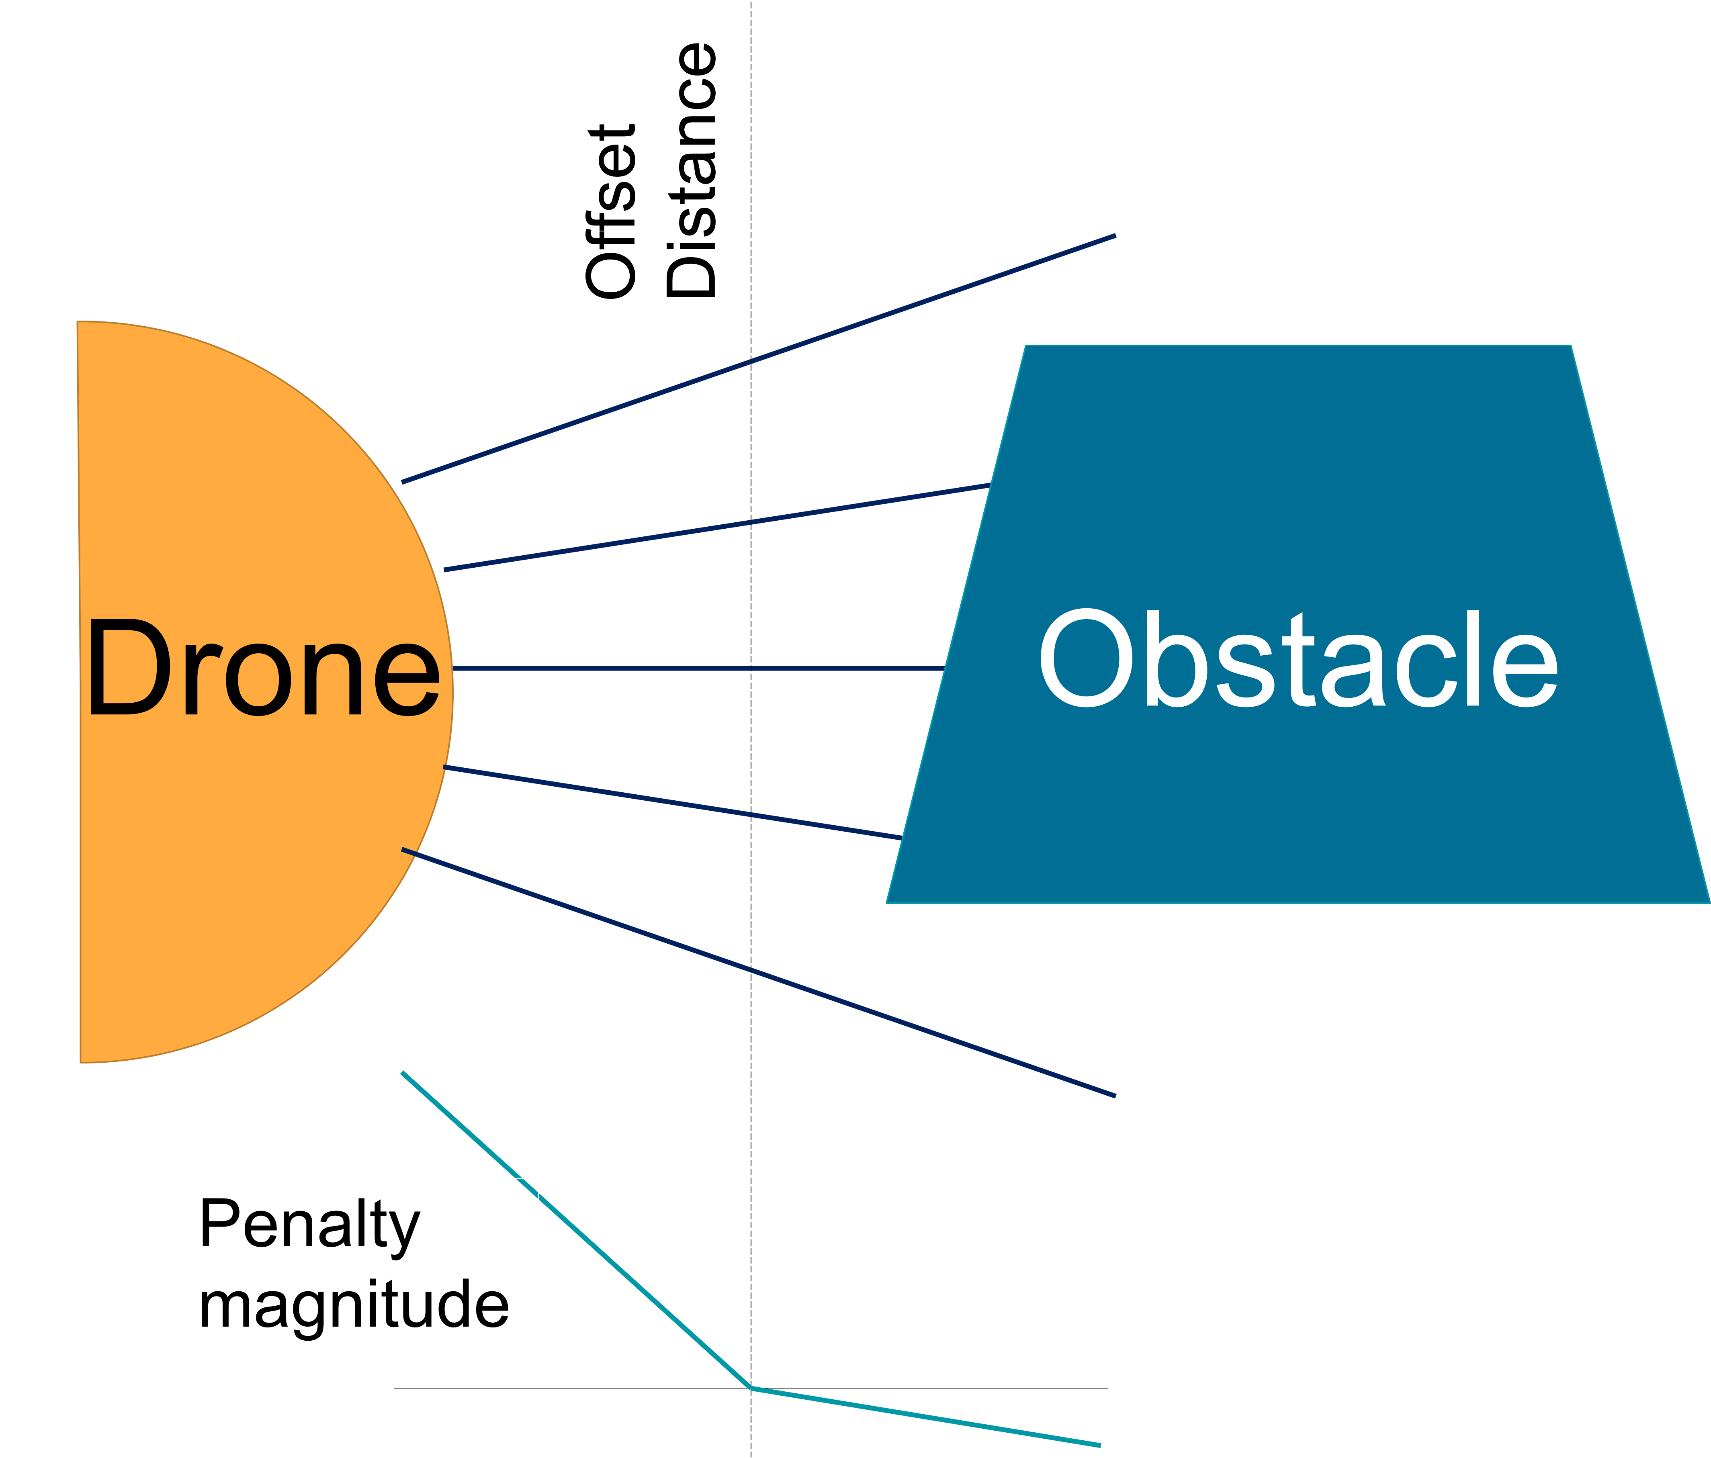
Methodology
Implemented methodology based on Lunar Landing simulation variations in Gymnasium using DQN
Leaky ReLU based penalty for obstacle collision
Penalty for taking action + distance and angular deviation from goal
Reward for reducing these differences
Maximum time duration of each episode specified

Slide 5
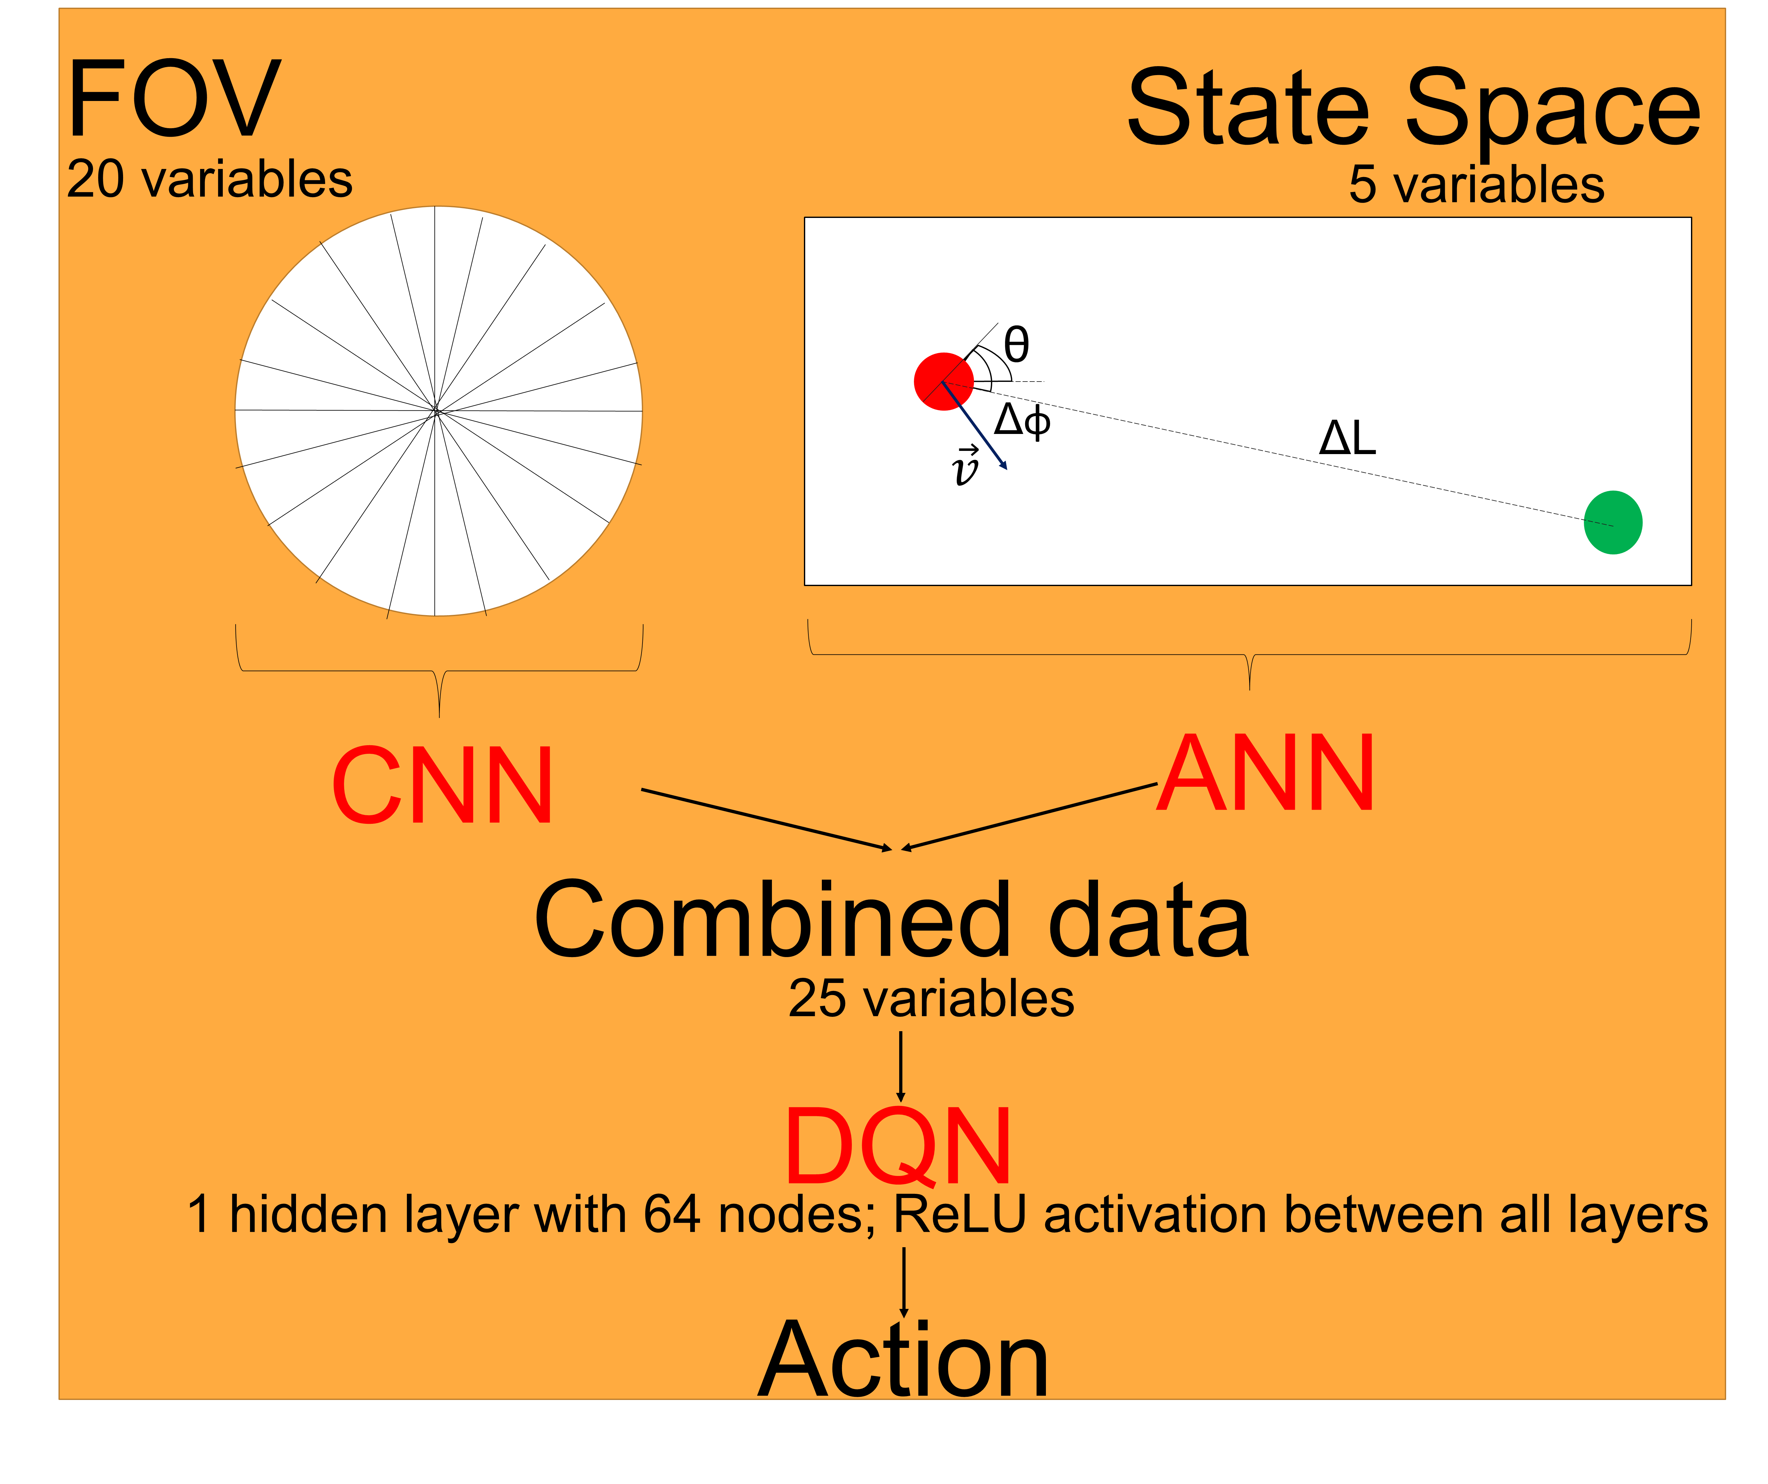
Learning Methodology

Slide 6
Results
Text goes here
Figures/Charts (if any)
Tables (if any)
Theoretical results (if any)

Slide 7
Conclusion and Future work
Deep Q-Network (DQN) successful in autonomous drone path formulation
Dependence of obstacle penalty on activation function used has significant impact on learning
Continuous action space attempted: issues with action decision identified
DQN augmented with CNN/ ANN for better interpretation of input fed to DQN
Potential Improvements:
Extension to 3-dimension
Effect of physics-based interactions (e.g. using fluid pressure for penalty) between obstacles and drone on training

Slide 8
Significant References
Gymnasium Documentation: Lunar Lander; https://gymnasium.farama.org/environments/box2d/lunar_lander/
Lunar Lander: DQN and variants; https://www.kaggle.com/code/auxeno/lunar-lander-dqn-and-variants?scriptVersionId=135585373
Lei He, Nabil Aouf, and Bifeng Song. 2021. Explainable Deep Reinforcement Learning for UAV autonomous path planning. Aerospace Science and Technology 118 (2021), 107052. https://doi.org/10.1016/j.ast.2021.107052

Slide 9
Offset Distance
Offset Distance
Obstacle
Drone
Penalty magnitude
State Space: [v_{x} v_{y} θ ΔL Δφ]

Slide 10

FOV
State Space
20 variables
5 variables
θ
Δφ
ΔL
$$\vec{v}$$
CNN
ANN
Combined data
25 variables
DQN
1 hidden layer with 64 nodes; ReLU activation between all layers
Action

